Slide 1
Bad loan Prediction

Slide 2
Data Science Project
Problem Statement
Data Gathering
Data Preparation
Feature Engineering
Feature Selection
Model Building
Evaluation
Deployment

Slide 3
Problem
Data contains complete loan data.
Given data is labeled.(bad_loan: 0/1)
To apply machine learning techniques to predict whether the loan will end up in "Good" or "Bad" status.

Slide 4
1. Data Gathering : Feature Set
Feature | Description
loan_amnt | Loan amount borrowed by user
term | The number of payments on the loan. Values are in months and can be either 36 or 60.
emp_length | Employment Length
int_rate | Interest Rate on the loan
home_ownership | The home ownership status provided by the borrower during registration. Our values are: RENT, OWN, MORTGAGE, OTHER.
annual_inc | The annual income provided by the borrower .
purpose | Purpose of the loan
dti | Debt-income ratio of the borrower
deling_2yrs | The number of 30+ days past-due incidences of delinquency in the borrower's credit file for the past 2 years
revol_util | The amount of credit the borrower is using relative to all available revolving credit.
total_acc | The total number of credit lines currently in the borrower's credit file
verification status | Verified / Not verified

Slide 5
Dataset
Samples: 1,63,987
Features: 15
Categorical features: 5
Numeric Features: 10

Slide 6
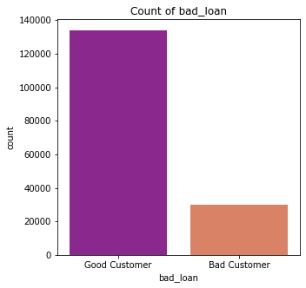
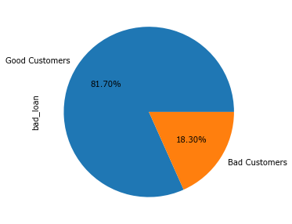
2. Data Preparation : Exploratory Data Analysis
bad_loan: target feature
Dataset is imbalanced : Boosting , Bagging ,Oversampling / Undersampling to deal with imbalanced dataset.

Slide 7
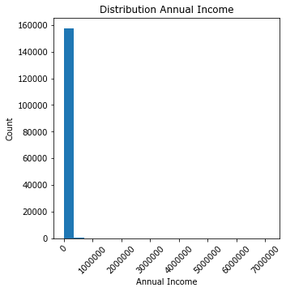
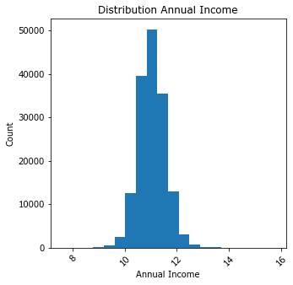
Skewness has been observed in distribution of Annual Income which can be removed with log transformation
Distribution of Annual Income
Log Transformation on Annual Income

Slide 8
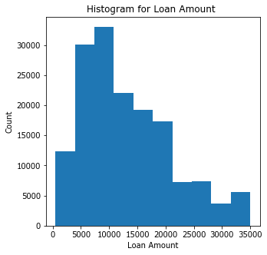
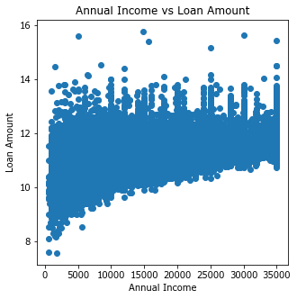
With increase in Annual Income approved Loan Amount increases
Distribution of loan amount
Annual Income – Loan Amount relationship

Slide 9
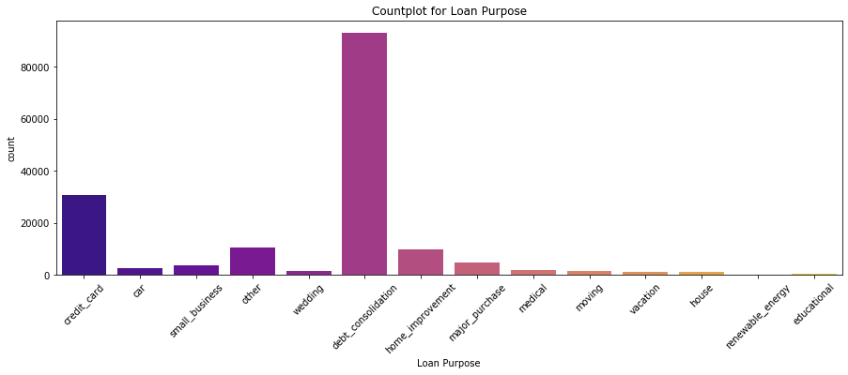
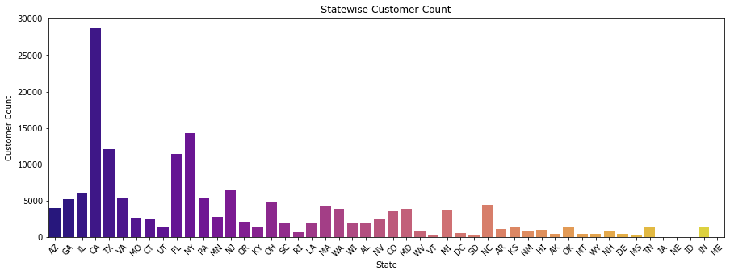
#No of borrowers per purpose
#No of borrowers per state

Slide 10
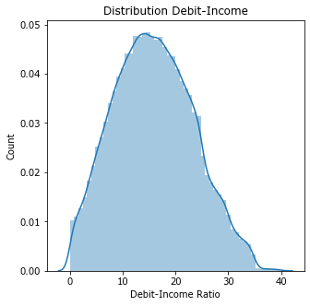
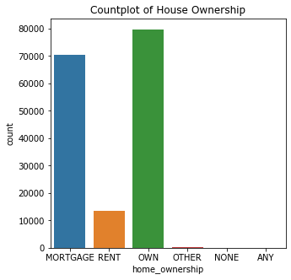
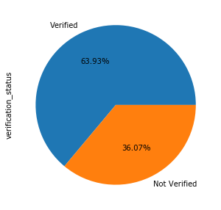
Distribution of debt-income ratio
Distribution of revol_util
#Count of House Ownership
Verification Status

Slide 11
Missing Values can be replaced by median in continuous feature or with mode in categorical feature
3. Feature Engineering
3.1 Missing Values
Feature | % of Missing values
emp_length | 3.54
annual_inc | 0.0024
delinq_2yrs | 0.0177
revol_util | 0.1177
total_acc | 0.0177
longest_credit_length | 0.0177

Slide 12
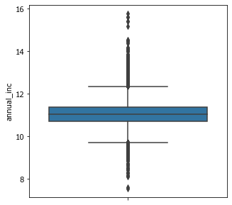
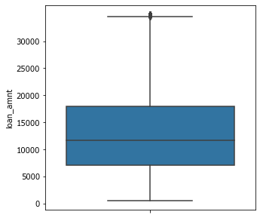
3.2 Outlier Detection
Annual Income
Loan Amount
RobustScaler: Scales features using statistics that are robust to outliers.This scaler removes the median and scales the data according to the quantile range

Slide 13
3.3 Categorical Numeric conversion
Categorical Features:
term
home_ownership
purpose
addr_state
verification_status
Label Encoder : To transform features to numeric features

Slide 14
3.4 Feature Scaling
Robust Scaler: RobustScaler()
Scales features using statistics that are robust to outliers.
Removes the median and scales the data according to the quantile range
Pearson’s Correlation Coefficient
>0.8 : Strongly correlated , features are redundant
<0.05: irrelevant / less impact on target feature 'emp_length', 'home_ownership', 'addr_state', 'longest_credit_length', 'purpose', 'total_acc', 'delinq_2yrs'} ,Total No of features: 7
3.5 Feature Selection

Slide 15
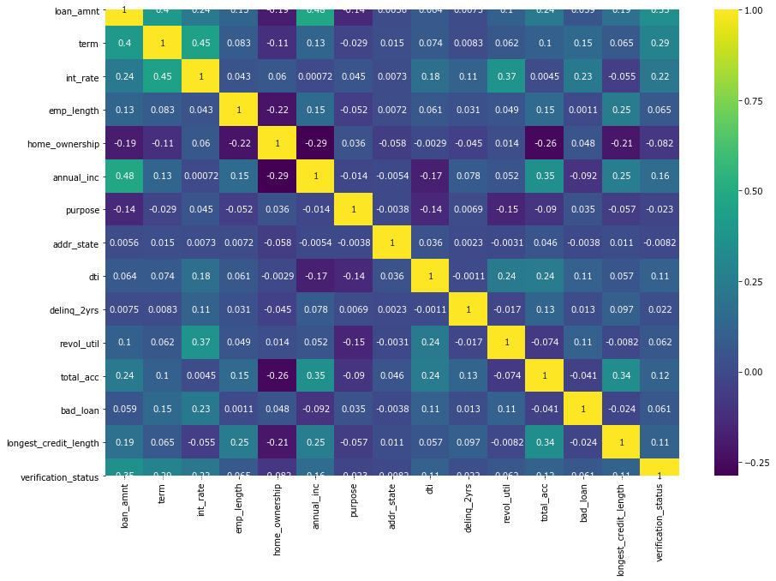
Correlation Matrix

Slide 16

4. Classification Model
Train-Test Split: (80%,20%)
Evaluation: K-Fold Cross Validation. (cv=10)
Accuracy:
Classification Technique | Accuracy |  | Feature Selection
 | Without CV | With CV | Not Applied(All Features) | Applied(Selected Features)
Decision Tree | 71.41 | 71.03 | 71.39 | 70.76
Logistic Regression | 81.6 | 81.66 | 81.61 | 81.63
Random Forest | 80.94 | 80.82 | 80.6 | 80.49
ADABoost | 81.7 | 81.64 | 81.78 | 81.67

Slide 17
Handling Imbalanced dataset
Random Over Sampling: To generate new samples by randomly sampling the current available samples.
SMOTE: Synthetic Minority Oversampling Technique

Slide 18
SMOTE:
Library: imblearn.over_sampling
Choose a minority class input vector
Find its k nearest neighbors (k_neighbors is specified as an argument in the SMOTE() function)
Choose one of these neighbors and place a synthetic point anywhere on the line joining the point under consideration and its chosen neighbor
Repeat the steps until data is balanced

